Slide 1
Websites factory DRUPAL 8
Webform
Digital corparate
May 2020

Slide 2
Webform

Slide 3
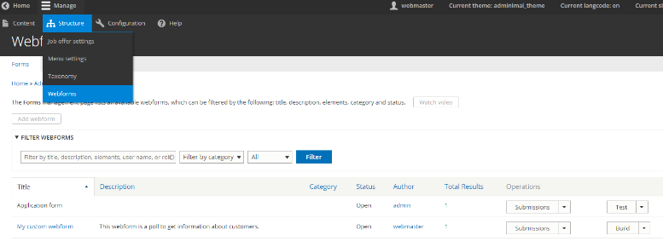
How to manage webforms?
WEBFORM
Webforms are forms that you can build and embed into your content
directly from the Drupal back-office.
Building a webform is done by adding elements (textfields, numeric fields…) with few clicks.

Slide 4
How to manage webforms?
WEBFORM
To manage webforms, go to /admin/structure/webform

Slide 5
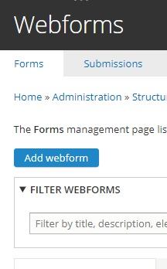
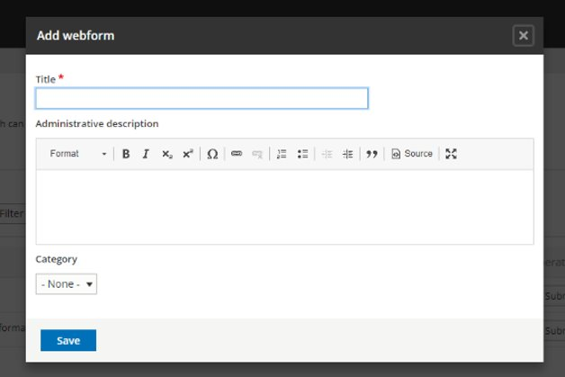
How to add webforms?
WEBFORM
1- To add a new webform, click on the « add webform » button
2- Give a title and description to your webform

Slide 6
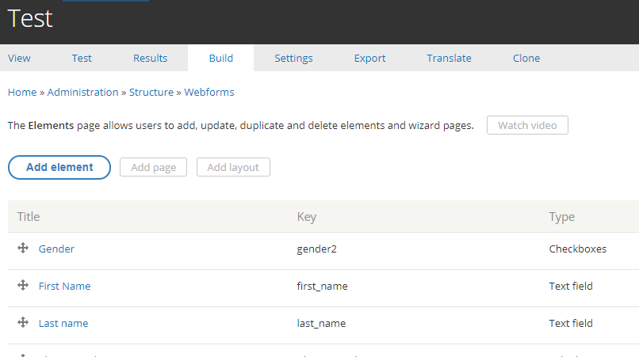
How to manage webforms?
WEBFORM
You can add elements and pages to your webform in the build section
Elements are form elements (textfield, email, radio button, checkbox, select list…)
Elements can be reorganized by dragging and dropping them by clicking on the handlebar next to them.
.

Slide 7
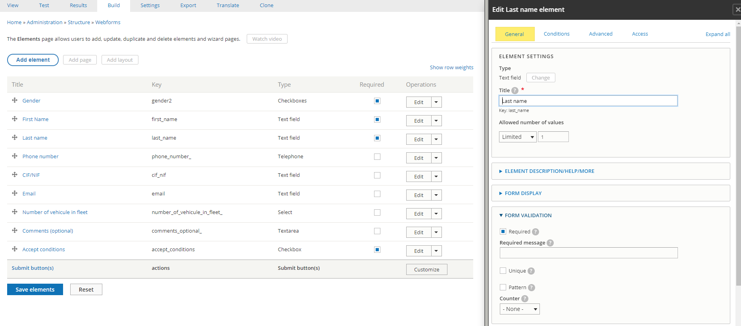
How to manage webforms?
WEBFORM
You can customize elements by clicking on their « edit » operation button.
The customization depends on each element but it is quite powerful.
Don’t hesitate to test all the possibilities.

Slide 8
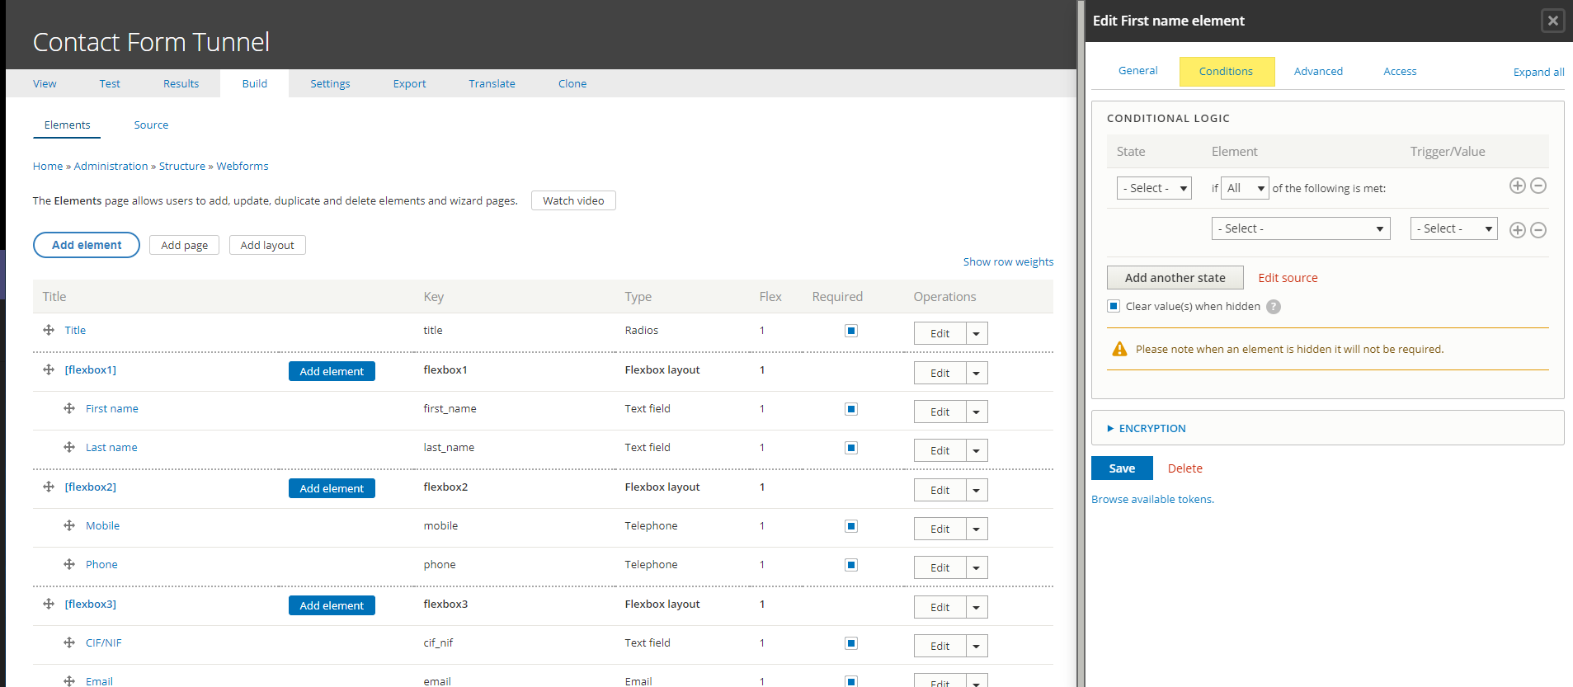
How to manage webforms?
WEBFORM
You can conditionalize elements by clicking on their « Conditions » tab in edit element.

Slide 9
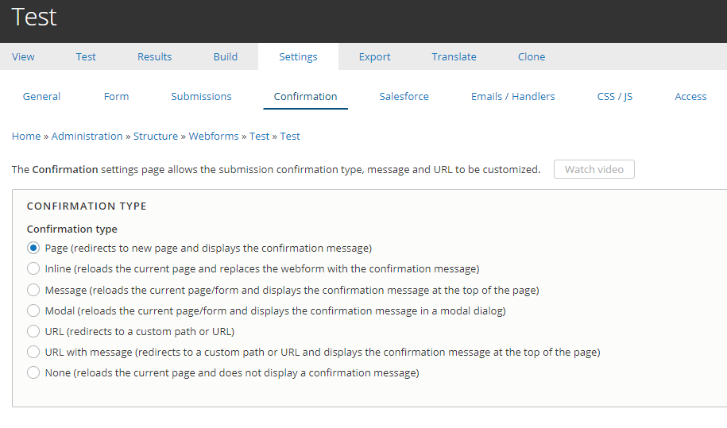
How to manage webforms?
WEBFORM
You can customize other aspects of the webform in the Settings Tab

Slide 10
How to manage webforms?
WEBFORM
You can customize other aspects of the webform in the Settings Tab:
Confirmation options
Salesforce
Emails
….

Slide 11
How to manage webforms?
WEBFORM
You can customize other aspects of the webform in the Settings Tab:
Confirmation options
Salesforce
Emails
….

Slide 12
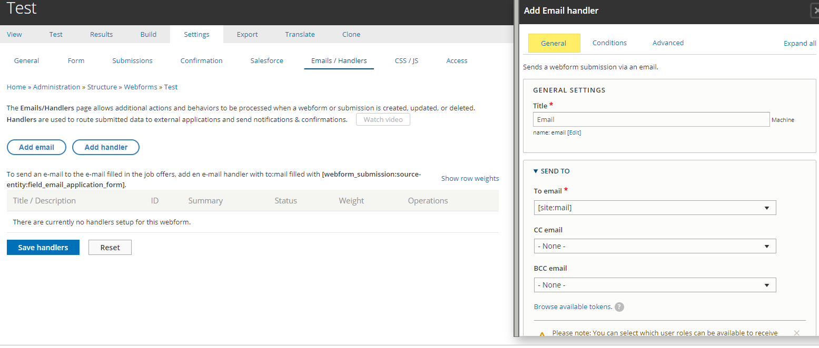
How to manage webforms?
WEBFORM
You can customize other aspects of the webform in the Settings Tab:
Confirmation options
Salesforce
Emails
….

Slide 13
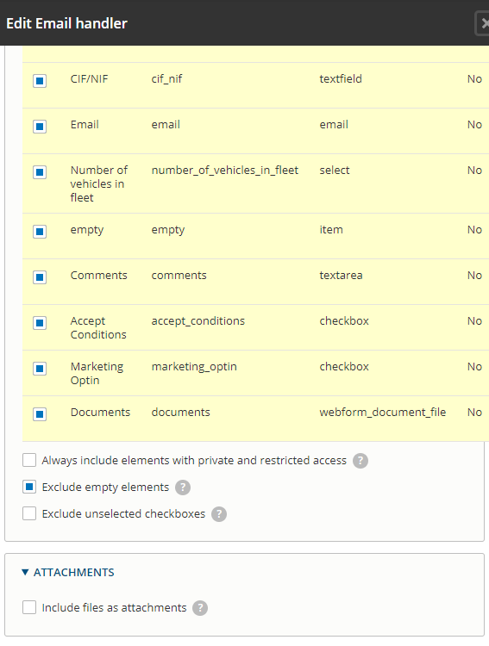
How to manage webforms?
WEBFORM
You can include webform files as attachments in email with this options in email handler:

Slide 14
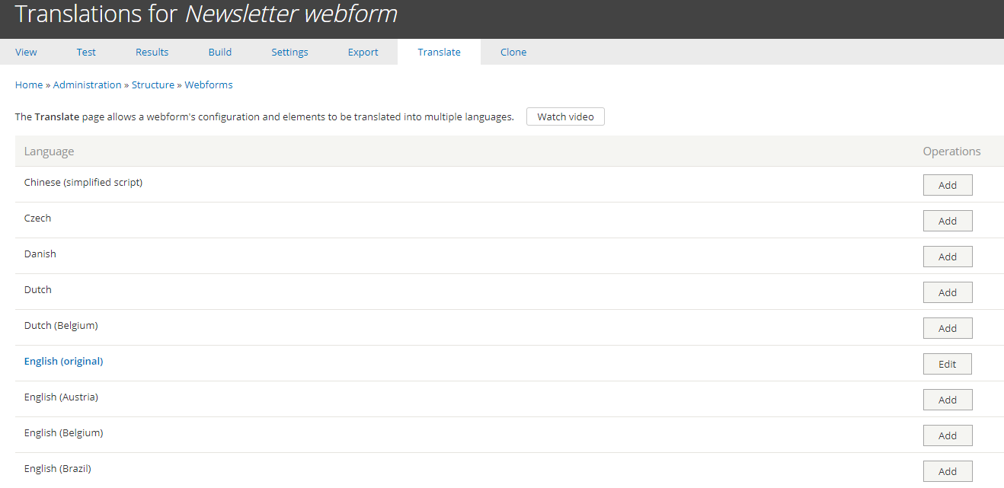
How to manage webforms?
WEBFORM
You can translate the webform in the TranslateTab

Slide 15
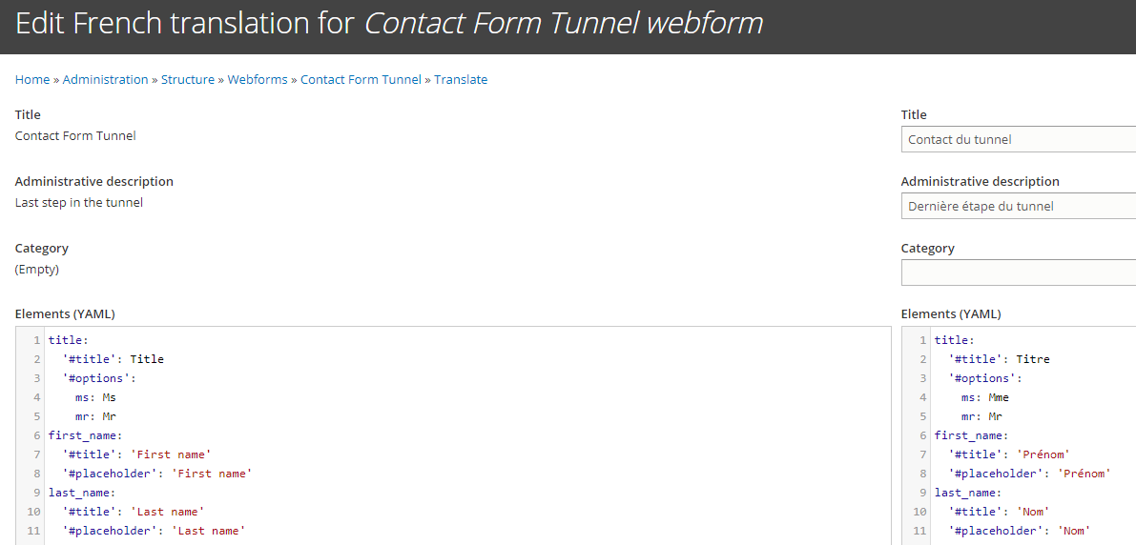
How to manage webforms?
WEBFORM
You can translate the webform in the TranslateTab

Slide 16
How to manage webforms?
WEBFORM
Once you are done with your webform, you need to embed it in your content.
To do so, edit a page you created and add a paragraph of type « webform ».

Slide 17
Webform linked to Salesforce

Slide 18
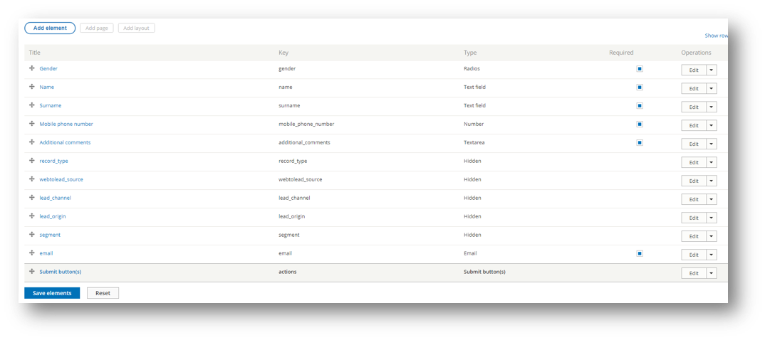
WEBFORM
Minimal configuration for Salesforce
in a webform
First of all, you have to create those 5 hidden field. They correspond to the minimum configuration to make Salesforce take in account your lead.
After that you can add what you want/need.

Slide 19
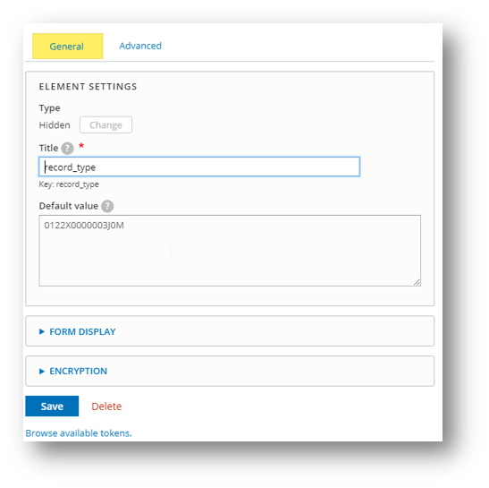
Webform linked to salesforce
WEBFORM
Each of those field have to be set with their default Value Key that you have get from salesforce.

Slide 20
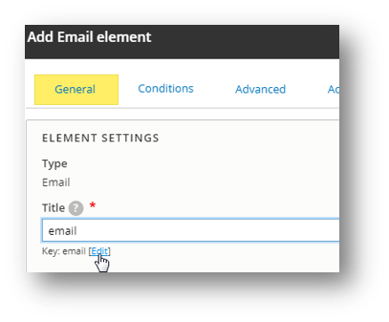
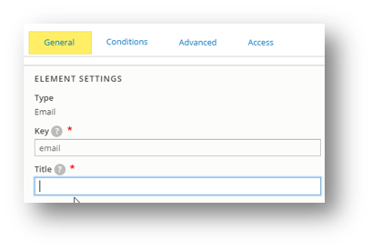
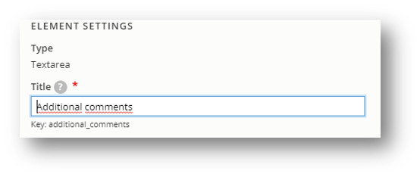
Webform linked to salesforce
WEBFORM
When you add field and you want it to be visible on salesforce, you have to add the key. This key is provided by Salesforce and can be modified only during the creation of you field. If you save it you will not be able to change to key.
1
Example of saved field
2

Slide 21
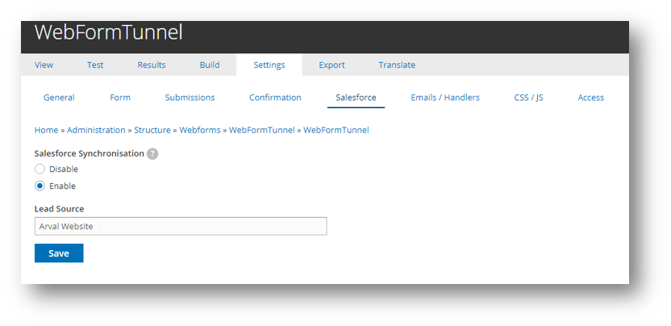
Webform linked to salesforce
WEBFORM
Last step before to save your webform you have to activate salesforce on it.
Settings > Salesforce > Enable + lead source

Slide 22
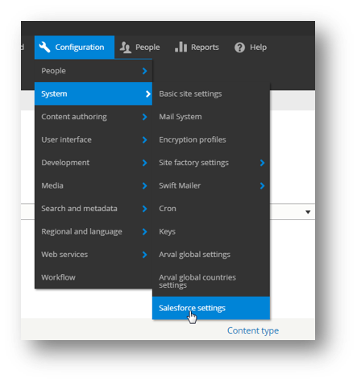
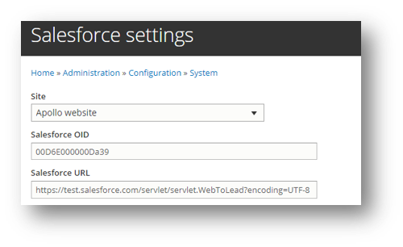
Drupal configuration for Salesforce
WEBFORM
After creation of your webform, you have to configure salesforce settings in the drupal.
First configure Salesforce OID and URL.
(you have to contact a Salesforce manager to get those information).

Slide 23
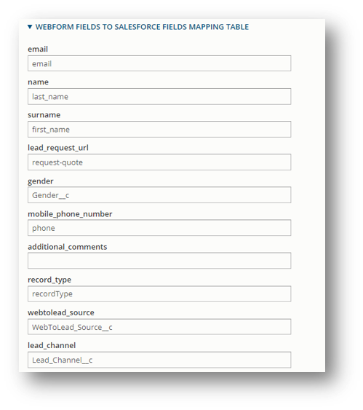
Mapping
WEBFORM
This table reference all the fields that you’ve created in your webform.
As you can see in the screenshot, you have to link all of those with a salesforce ID.

