Slide 1
Creating a newsroom on the CMS
Drupal 8
User guide
May 2020

Slide 2
Summary
News creation
News configuration
News layers
News - search/list
Header focus tab
News highlight
News highlight banner
Newsroom – Quote banner
News banner

Slide 3
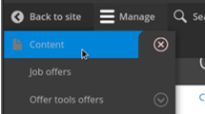
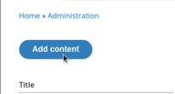
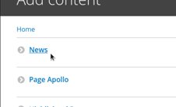
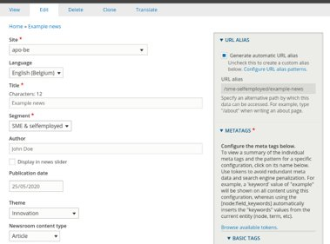
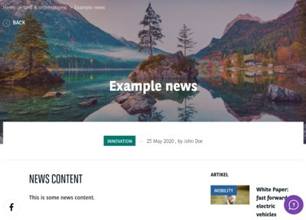
1. News creation (1/2)
Location: Manage > Content > Add content > News​
>​
>​

Slide 4
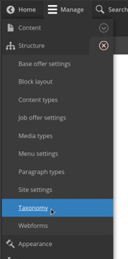
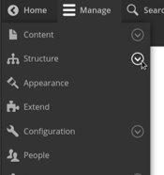
1. News creation (2/2)
Create a news theme / content type:
Manage > Structure > Taxonomy > Newsroom content type / theme > Add terms
>​
>​

Slide 5
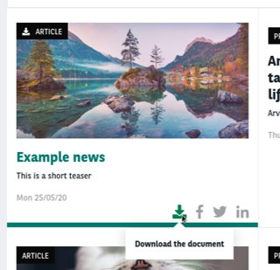
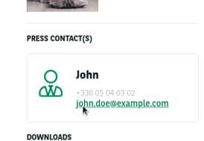
2. News configuration
The display field:​
"Resource" will display a download button on result lists.​
"Press-Release" will display press contacts on detail page.​
The theme field:​
Theme is used to change the news main color in a lot of displays. ​
A color field is available on theme taxonomy terms.

Slide 6
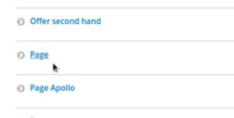
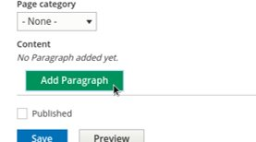
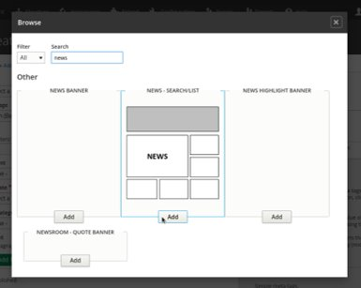
3. News layers
Location: Content > Add content > Page / Apollo page > Add paragraph
>​
>​
>​

Slide 7
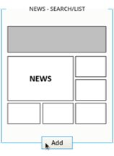
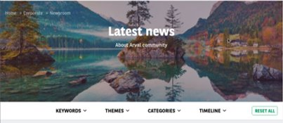
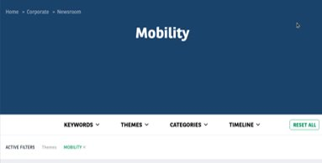
3. A. News – Search/List (1/2)
Presentation:​
This layer shows all published news available on your site. It also provides a search form to filter displayed news.​
News list header:
The news list header is dynamically generated. It can be replaced by theme informations if only one theme is selected.
This header can also be replaced by some paragraphs. See following paragraphs for more infos.

Slide 8
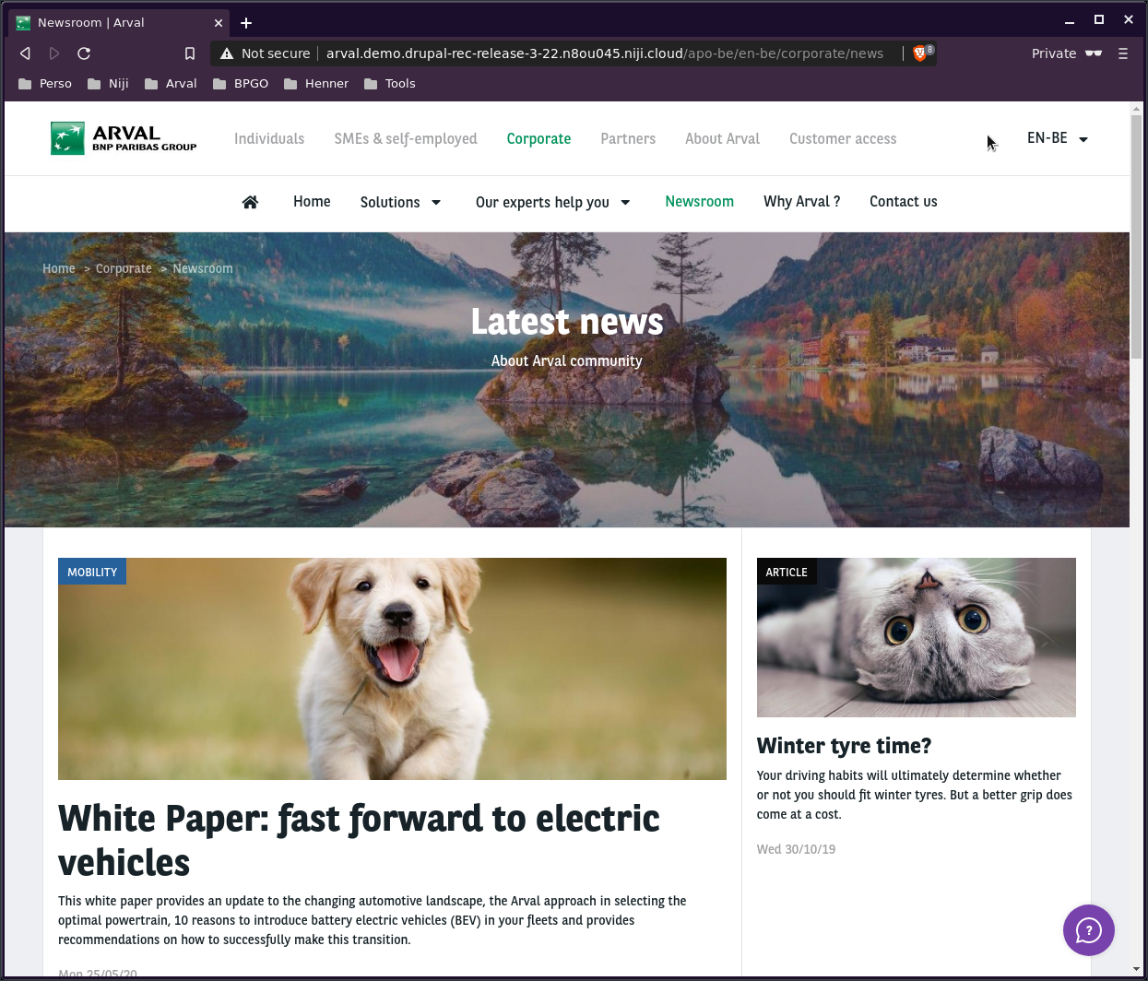
3. A. News – Search/List (2/2)
Prefilter news list:
You can prefilter your result list using themes and content types.
When a list is prefiltered, exposed filters are no longer availables.

Slide 9
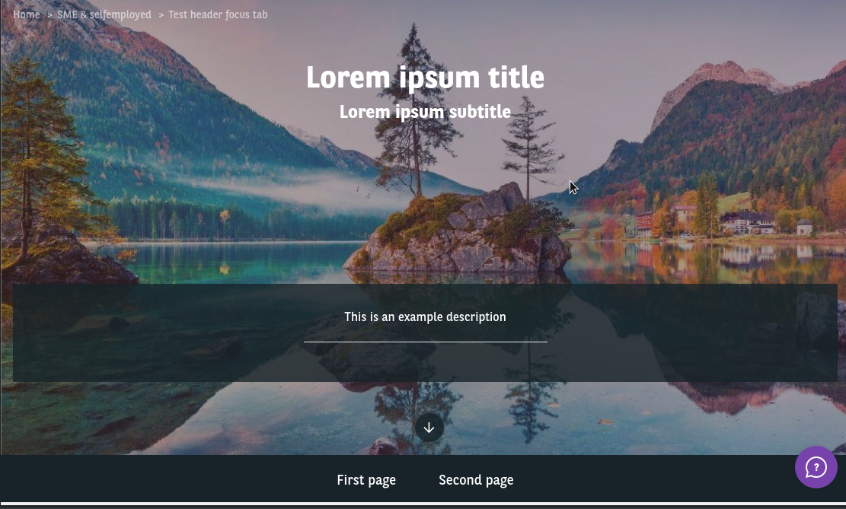
3. B. Header focus tab (1/3)
Presentation:​
This layer allows you to have a similar header on multiple pages, with an integrated navigation. Therefore, the layer isn't automatically generated in each pages, a proper contribution needs to be done.
The header focus tab aims to be the first paragraph of a page content. If not, it will not properly display its content.

Slide 10
3. B. Header focus tab (2/3)
Highlighted links:
When a user navigate using the tabs of this layer, links can be highlighted. To properly use this feature, you must reference existing Drupal pages on the link fields.
Cloning pages:
To properly duplicate a header focus tab layer, you can clone the page where it was contributed on the first time. Keep in mind to update the links with the new pages if needed.

Slide 11
3. B. Header focus tab (3/3)
Using header focus tab layer with news search list layer:
You can use both header focus tab and news search list layers on the same page. To get it working, the header focus tab must be the first layer of the page, just before the news search list layer. If so, the header of the news search list is totally replaced with the header focus tab content.

Slide 12
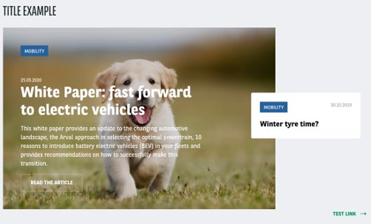
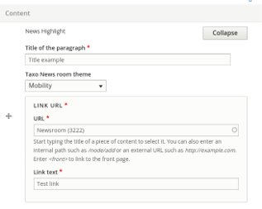
3. C. News highlight
Presentation:​
This paragraph shows the last 4 published news, highlighting the first one.
Filtering news:
You can filter showed news using an optional theme filter.

Slide 13
3. D. News highlight banner
Presentation:​
Highlight a single news.

Slide 14
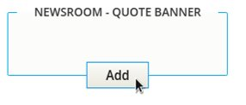
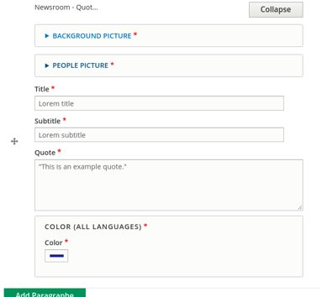
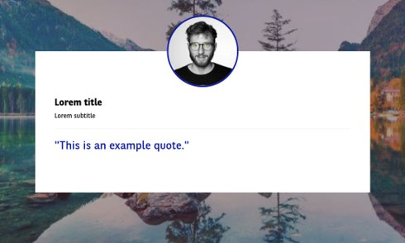
3. E. Newsroom – Quote banner
Presentation:​
Display a written quote with some pictures with an editable highligted color.

Slide 15
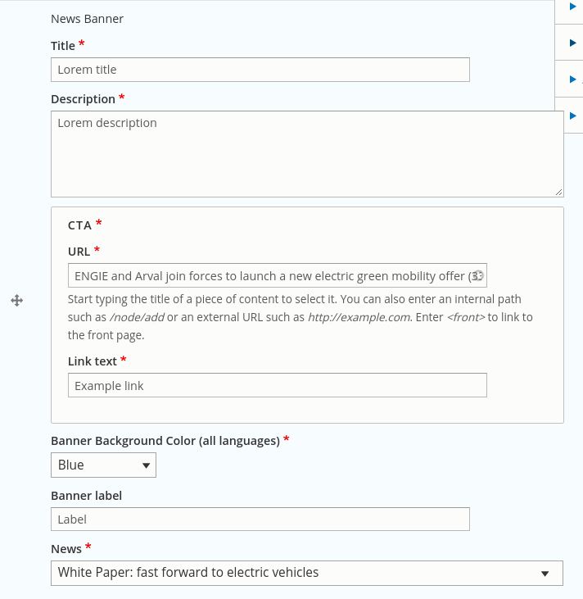
3. F. News banner
Presentation:​
Display a single news with some marketing informations, with an editable highligted color.

