Slide 1
Creating a menu on the CMS
Drupal 8
User guide
May 2020

Slide 2
Summary
Menu creation
Main menu
Apollo main menu
Microsite main menu
Menu country
Contact menu
I need menu

Slide 3
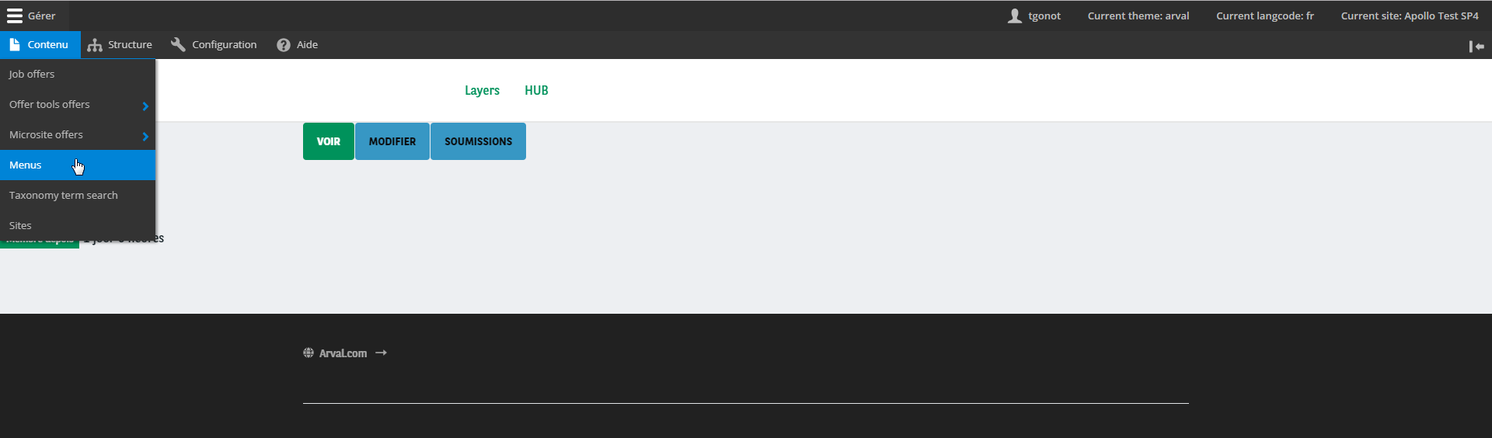
1. Menu creation (1/2)
To create a menu, you have to go on the page Content > Menu's :

Slide 4
1. Menu creation (2/2)
And add one :
*

Slide 5
2. Main menu
Main menus have the most complicated structure, because they have of differents hierarchical use cases. Be carefull if your site is a microsite or apollo site, the menu contribution will be slightly different.
Microsite main menu example
Apollo main menu example

Slide 6
2. A. Apollo main menu (1/2)
Apollo main menu is basically a list of microsite main menus, each one of these is wrapped into a segment information. The root items of an Apollo main menu are Segment items, with the same structure as microsite menus on its children field. See chapter 2.B. to better understand microsite menus.
On each page of an Apollo site, only children of the current segment are displayed.
Current segment
Children of current segment item

Slide 7
2. A. Apollo main menu (2/2)
Once your menu is properly created, your need to link it using the Apollo main menu field of your site configuration form, under Features > Menu's > Main menu section.

Slide 8
2. B. Microsite main menu (1/3)
A micosite main menu is a set of links, with children or not. A complete microsite structure uses 3 levels of herarchical elements, but you don't have to use all of these levels to get a working menu.
Here is an example of a simple microsite menu structure:
Menu
Basic item
Basic item
Basic item

Slide 9
2. B. Microsite main menu (2/3)
Here is another example, with a more complicated structure. The idea always stay the same, but here you can add children link to some elements:
Basic item
Submenu item
Submenu level 2 item
Basic item
Basic item
Submenu level 2 item
Rich item (only for microsite)
Rich item (only for microsite)
Level 1 links
Level 2 links
Level 3 links

Slide 10
2. B. Microsite main menu (3/3)
Once your menu is properly created, your need to link it using the Microsite main menu field of your site configuration form, under Features > Menu's > Main menu section.

Slide 11
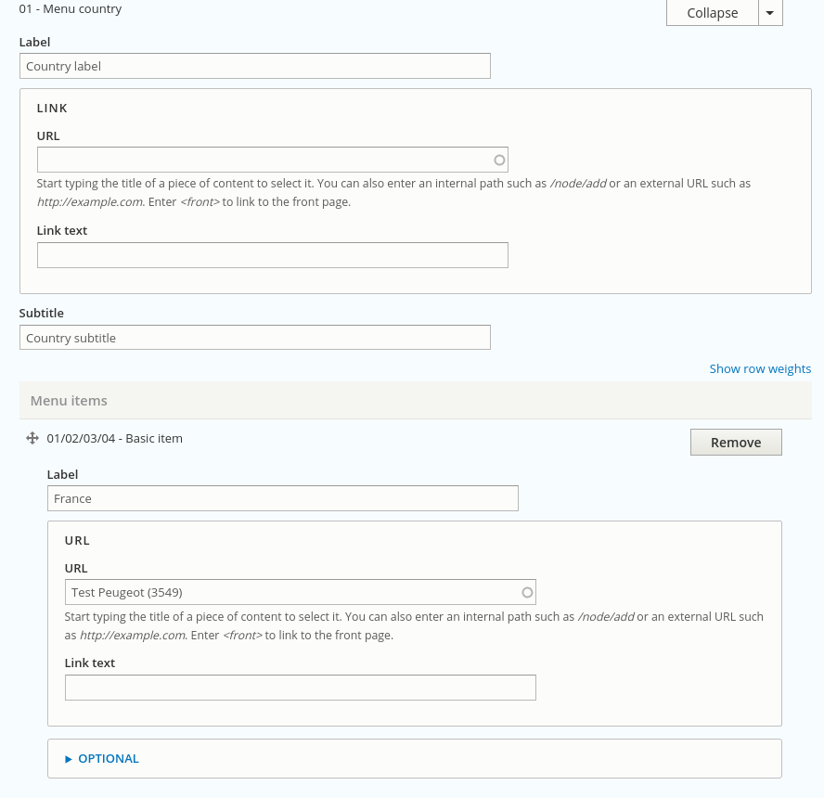
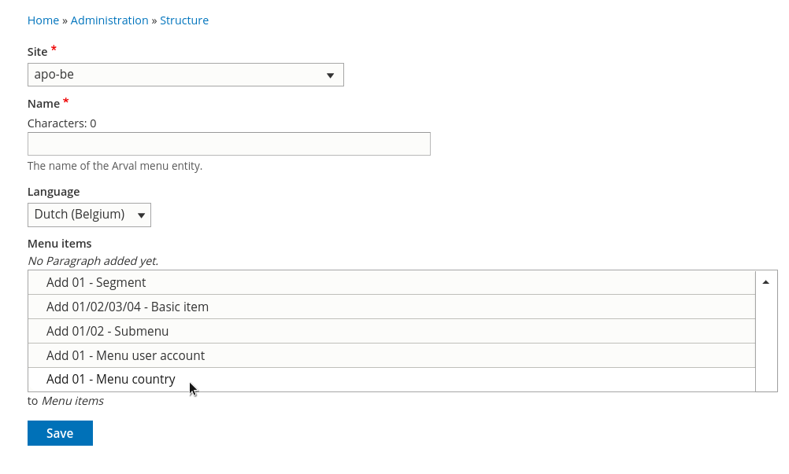
3. Menu country (1/2)
Microsite only
To create a country menu, you need to add a Menu country item as a root element of your menu.
When it's done, the menu country has a very simple structure: a list of basic menu items. Each item should have a picture.
Menu country data
Basic items data
...

Slide 12
3. Menu country (2/2)
Microsite only
Once your menu is properly created, your need to link it using the I Need Menu field of your site configuration form, under Features > Menu's section.
Menu country data
Basic items data

Slide 13
4. Contact menu (1/2)
The contact menu is a simple list of links with icons. It can also be used only with an image and a link, but icon and text is not recommended in that case. The contact menu works on both apollo and microsite, but with a different display.
Microsite contact menu
Apollo contact menu

Slide 14
4. Contact menu (2/2)
Once your menu is properly created, your need to link it using the Contact menu field of your site configuration form, under Features > Menu's section.

Slide 15
5. I need menu (1/2)
Microsite only
The I need menu is a submenu item as root item, with I need menu items as children. Each item is a link and a picture. Beware, the I need menu works only on microsite.
Submenu item
Menu - I need item
Menu - I need item

Slide 16
5. I need menu (2/2)
Microsite only
Once your menu is properly created, your need to link it using the I need menu field of your site configuration form, under Features > Menu's section.

