Slide 1
Websites factory DRUPAL 8
Geolocation
Training support
December 2019

Slide 2
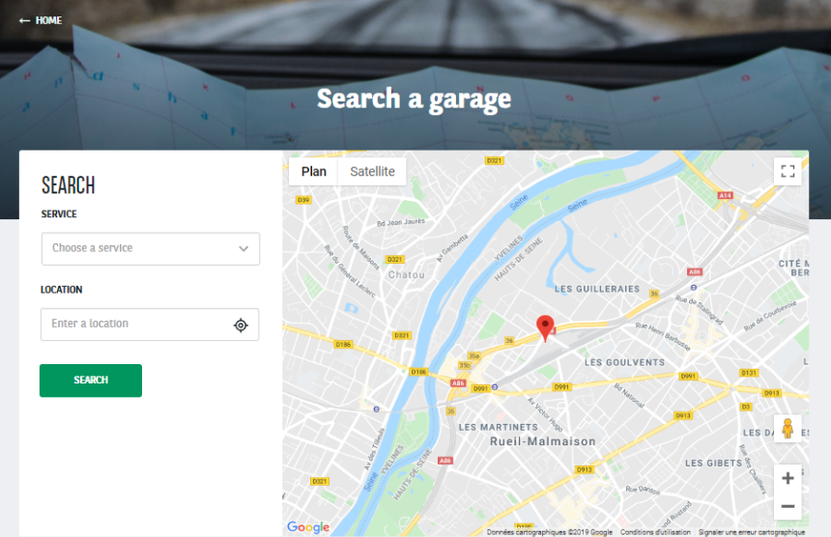
Why geolocation ?
Geolocation
The purpose of geolocation feature is to represent a map where it is possible to search for suppliers by activities, brands and location.

Slide 3
How to add geolocation content?
Geolocation
The main content of geolocation feature is the supplier content type.
A supplier is contact point information, which will appear on the geolocation map.
A supplier content can be added by:
Adding the supplier content in the content management page
Manually importing an xls file, which actions are:
Delete all suppliers of the current site
Import all taxonomies used on geolocation
Import all suppliers of the XLS file

Slide 4
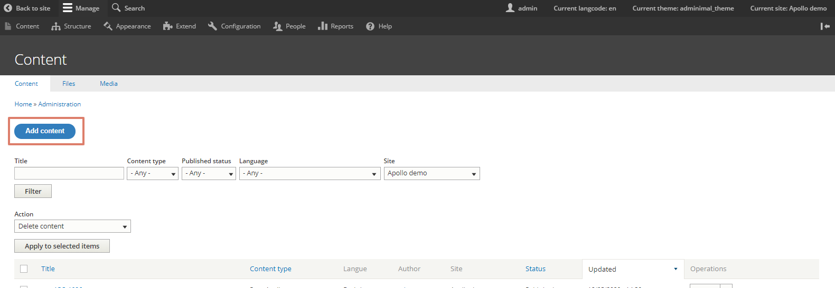
Add a supplier content
Geolocation
Choose the menu: Content > Add content > Add a supplier

Slide 5
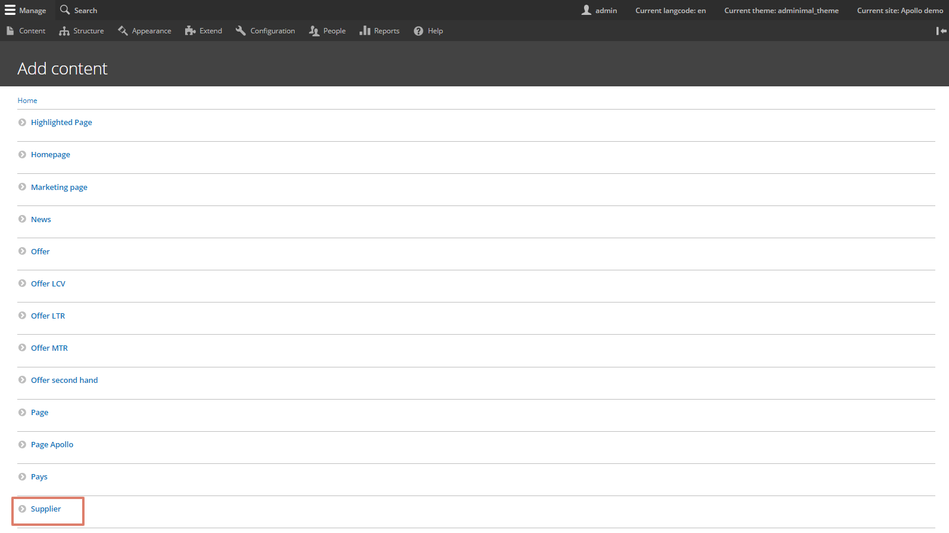
Add a supplier content
Geolocation

Slide 6
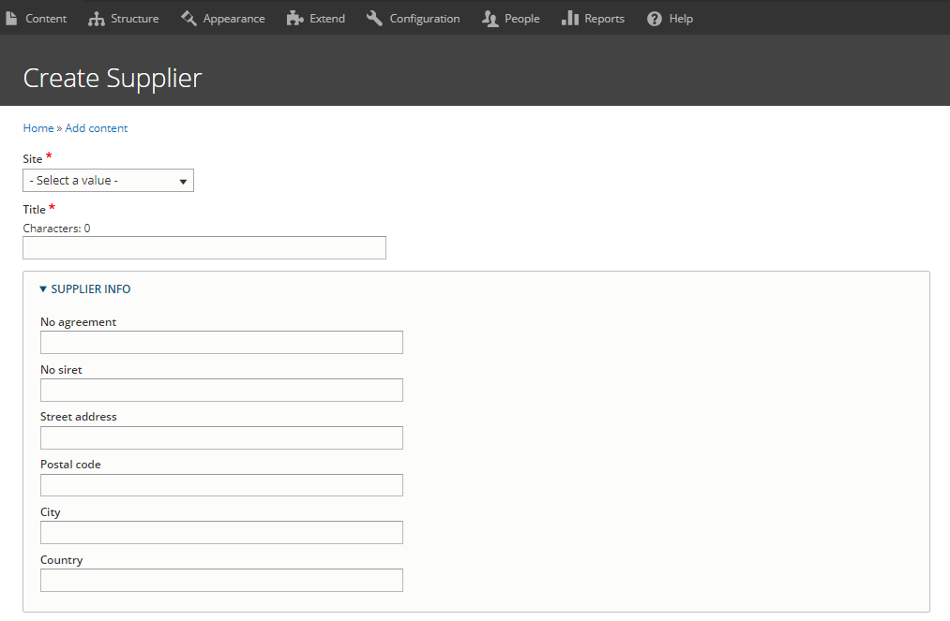
Add a supplier content
Geolocation

Slide 7
Add a supplier content
Geolocation
Fill in the supplier fields:
Site: mandatory field.
Title: mandatory field.
N° agreement
N° Siret: mandatory field.
Street adress
Postal code
City
Country

Slide 8
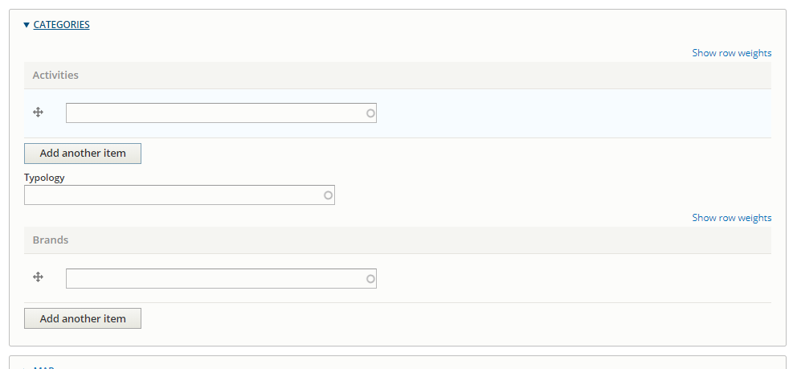
Add a supplier content
Geolocation

Slide 9
Add a supplier content
Geolocation
Fill in the category fields:
Activities: Reference to one or multiple supplier services taxonomy.
Typology: Reference to one supplier typology taxonomy.
Brands: Reference to one or multiple supplier services taxonomy.

Slide 10
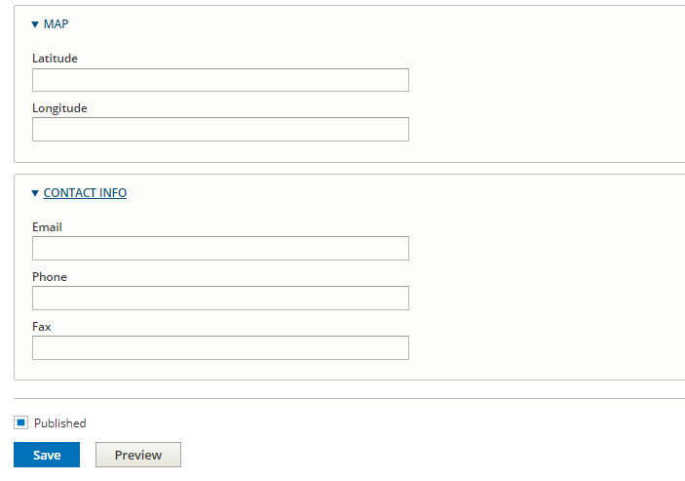
Add a supplier content
Geolocation

Slide 11
Add a supplier content
Geolocation
Fill in the Map and contact info of the supplier:
Map: Latitude and longitude. These are mandatory fields.
Contact info
Finally, set the status to published and save the content.

Slide 12
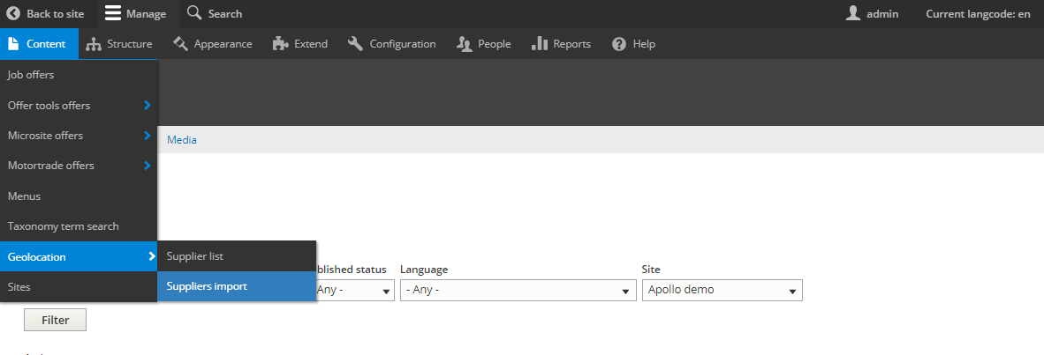
Import supplier content
Geolocation
Choose the menu: Content > Geolocation > Suppliers Import

Slide 13
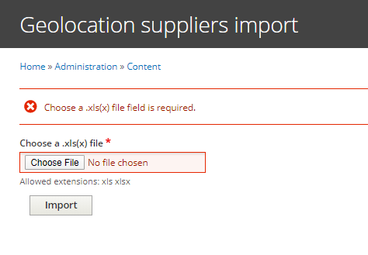
Import supplier content
Geolocation
Choose a xls file and click on import.

Slide 14
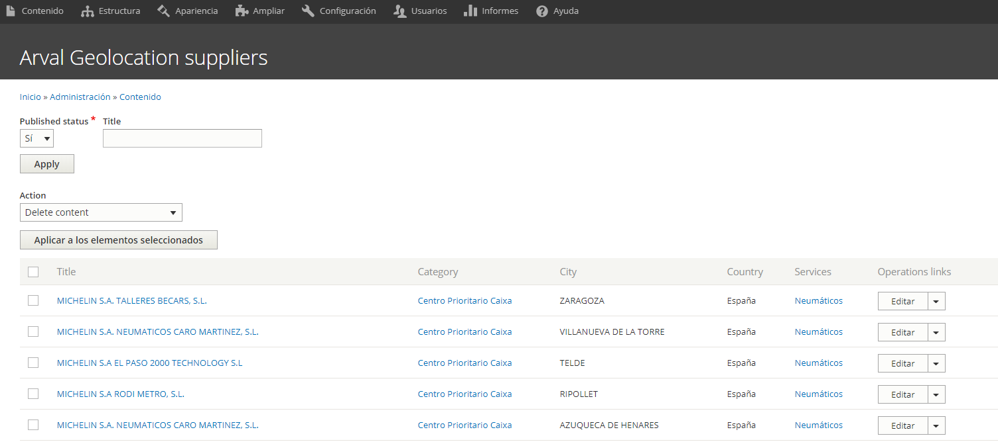
Supplier content List
Geolocation
To access the suppliers content listing:
Choose the menu: Content > Geolocation > Suppliers List

Slide 15
Geolocation taxonomies
Geolocation Taxonomies
To view the geolocation taxonomies.
Choose the menu: Structure > Taxonomies > Geolocation - ….
All geolocation taxonomies are prefixed by “Geolocation – “
Supplier activity
Supplier brand
Supplier typology
These taxonomies are imported with the suppliers, but some elements have to be added by the webmaster, for example the pictos in supplier typology.

Slide 16
Geolocation taxonomies
Geolocation Taxonomies
Supplier activity:
Allows to enter the different service activities of the suppliers, and also specify for which brands the service is available.
An example of supplier activities: Mechanical Repair, body repair, glass repair, …

Slide 17
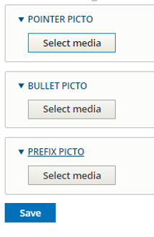
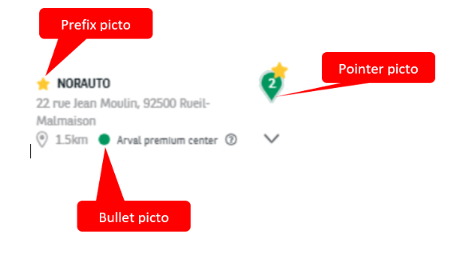
Geolocation taxonomies
Geolocation Taxonomies
Supplier typology: This taxonomy manages media for the map pointers:
Pointer picto: the picto that will be used on the map (mandatory)
Bullet picto: the picto that will be displayed before the category name on the list (not mandatory)
Prefix picto: the picto that will be displayed before the supplier name on the list (not mandatory)

Slide 18
Geolocation taxonomies
Geolocation Taxonomies
Supplier typology:
The order of the supplier typology in the taxonomy is used to sort the suppliers by recommendation in the geolocation listing.
It is recommended to review the weight of these taxonomy in the taxonomy term list and save.
First Supplier typologies will come first in the search page.
Example of typologies: Arval premium center, Arval center, arval agreed center, …

Slide 19
Geolocation taxonomies
Geolocation Taxonomies
Supplier brand:
Allows to enter the different brands.
For example: Alfa romeo, BMW, …

Slide 20
Add a geolocation page
Geolocation page
Choose the menu: Content > Add content > Apollo page
Add an Apollo page with a paragraph of type “Geolocation”:
Paragraph title
Header image
Country
Zoom: A zoom value from 0 to 20, where zoom 0 corresponds to a map of the Earth fully zoomed out, and 20 is a building focused map.
Distance: The research area (in meters) from the searched location.
Example: if I search Madrid and this field is filled with 5000, every supplier within 5km of Madrid center will appear.

Slide 21
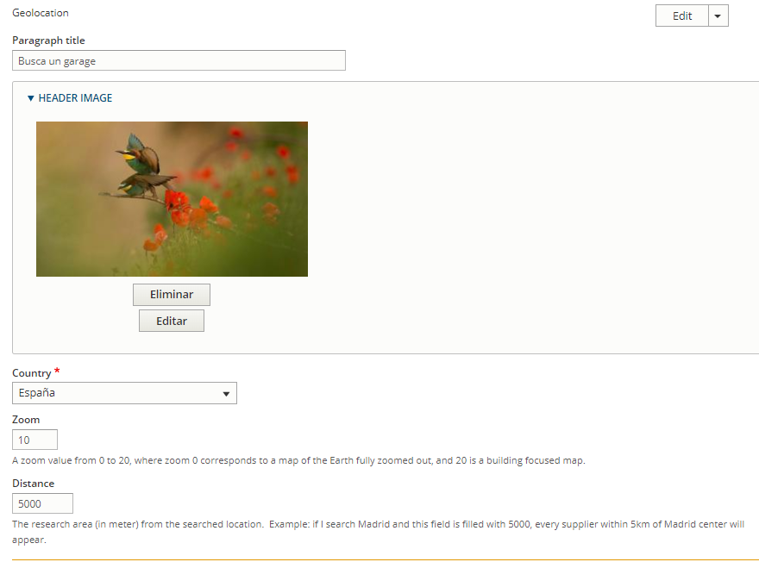
Add a geolocation page
Geolocation page

Slide 22
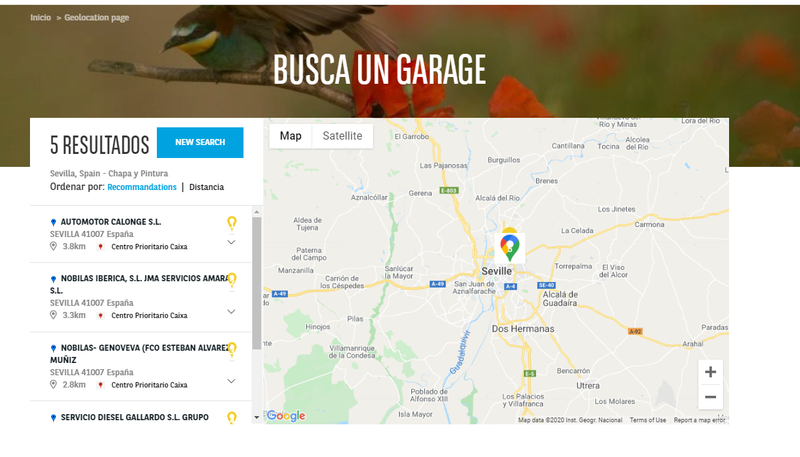
Add a geolocation page
Geolocation page

